Slide 1
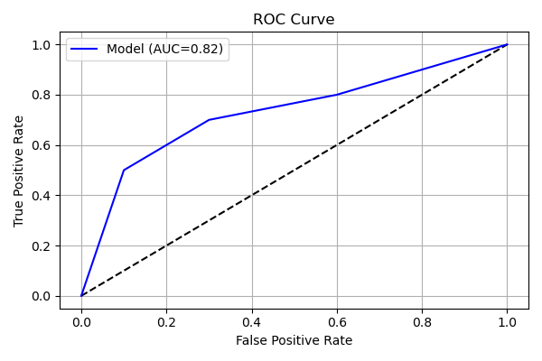
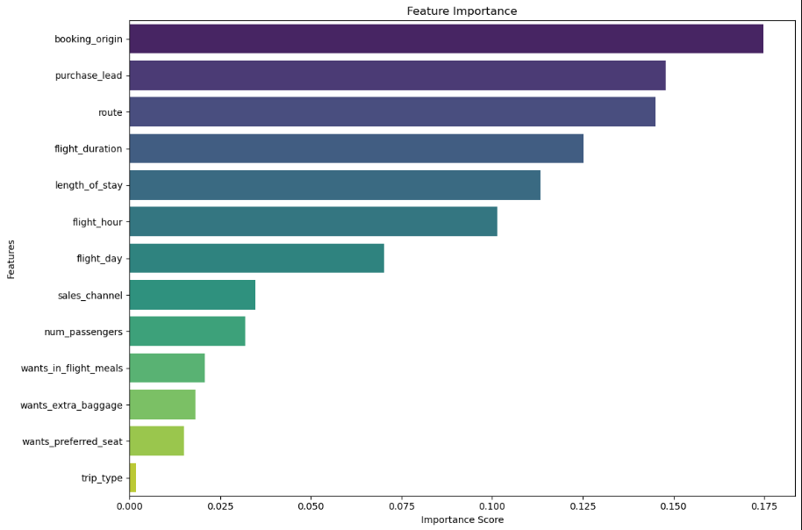
Customer Booking Prediction Model
Using Random Forest Algorithm

Slide 2
Summary Findings
Dataset Overview:
- 50,000 records with 14 features.
- Target variable (`booking_complete`) is imbalanced (15% positive class).
Model: Random Forest
- Handles categorical & numerical features.
- Provides feature importance insights.
Model Performance:
- Precision: 57% (Booking Complete)
- Recall: 68%
- ROC-AUC: 0.82
Key Influencers:
- `purchase_lead`, `route`, `length_of_stay`, `flight_duration`, and `trip_type`.
Actions Taken:
- Preprocessing: Label encoding, SMOTE for class imbalance, Standard scaling.
- Model Tuning: 100 estimators, balanced class weighting.
- Visualizations: ROC Curve, Feature Importance.
Recommendations:
- Focus on optimizing `purchase_lead` for targeted marketing.
- Refine routes to emphasize booking trends.
- Further tuning for improved recall of positive class.

